Slide 1
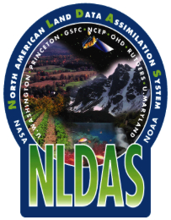
NLDAS CCB Briefing Meeting 18 April 2018
North American Land Data
Assimilation System (NLDAS)
Version 2.5.0 -- an Upgraded Implementation
Youlong Xia and Jack Kain
NCWCP, 5830 University Research Court, College Park, Maryland

Slide 2
NLDAS: Partners
NLDAS, Data Sets, Land Model Development:
− J. Kain, Y. Xia, H.Wei, J. Meng, J. Dong (NCEP/EMC)
− J. Sheffield, E. Wood et al (Princeton U.)
− D. Mocko, C. Peters-Lidard, S. Kumar (NASA/GSFC)
− B. Cosgrove, David Kitzmiller (NWS/NWC)
− D. Lettenmaier et al (UCLA)
− L. Luo (Michigan State University)
− Z-L Yang(UT-Austin), M. Ek(UCAR), and F. Chen(NCAR)
NLDAS Maintenance and Operational Transition:
− Y. Xia (NCEP/EMC), Simon Hsiao (NCO)
NLDAS Products Application:
− K. Mo, L. Chen, M. Chelliah, M. Rosencrans(NCEP/CPC)
− Eric Luebehusen (USDA), H. Rui (NASA), USDM Author Group, Regional Climate Centers
2

Slide 3
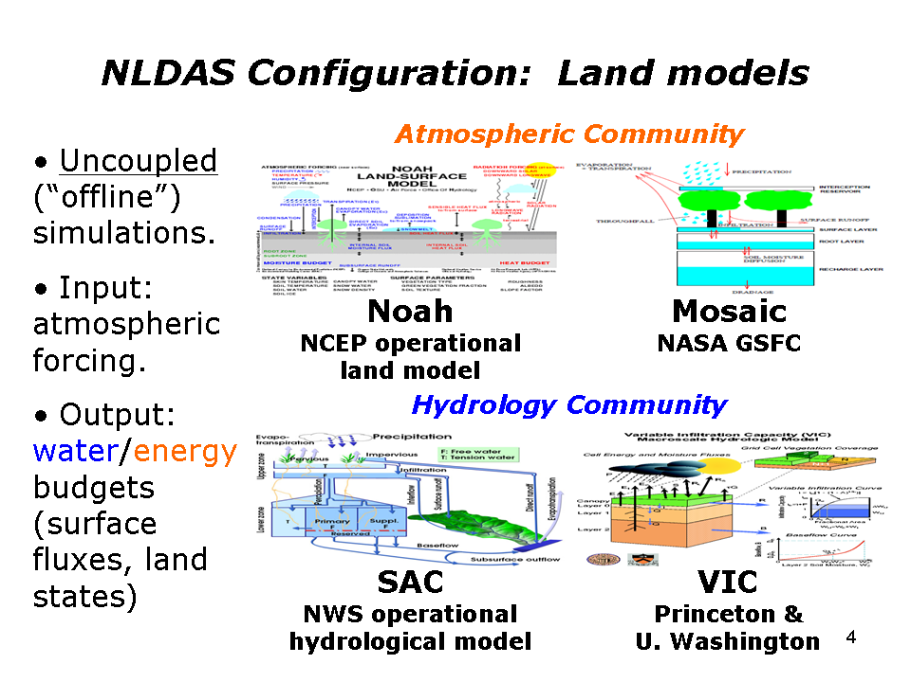
NLDAS: Land Models
Research Model
Operational Model
3

Slide 4
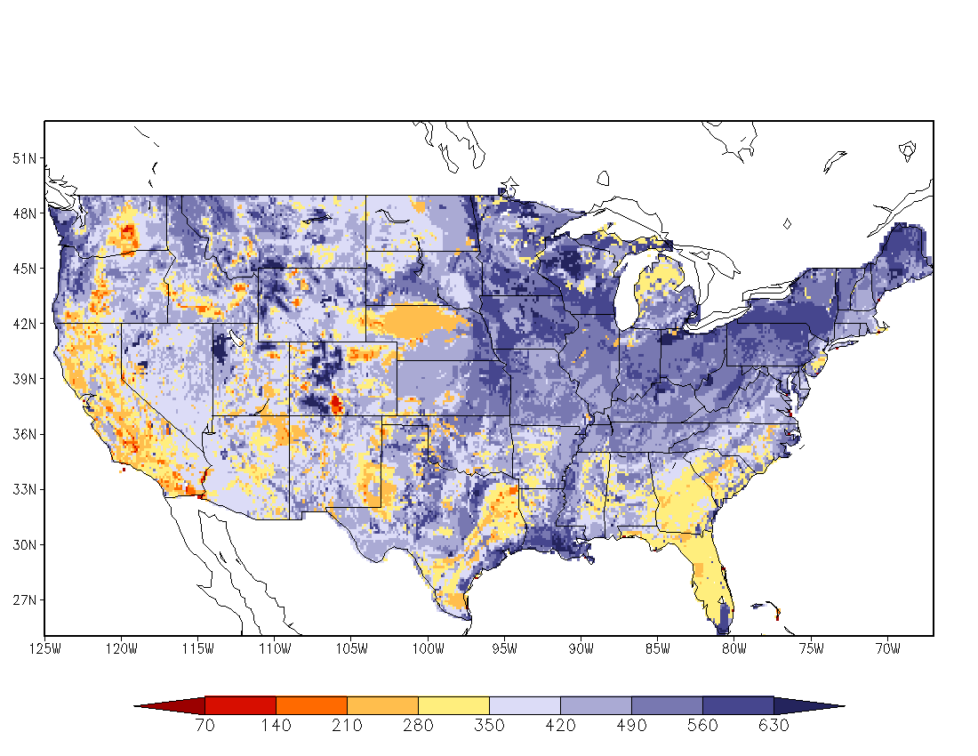
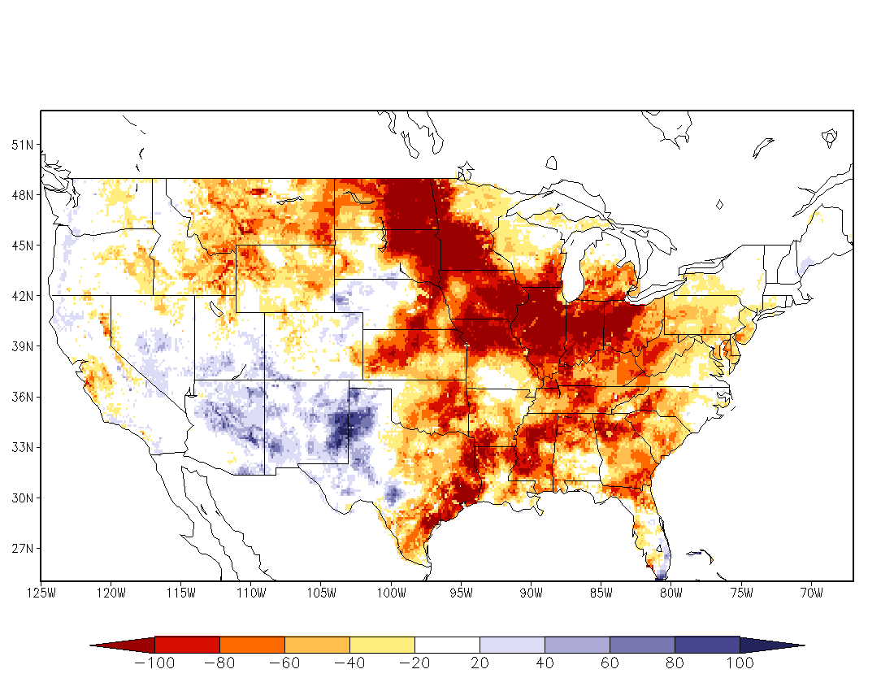
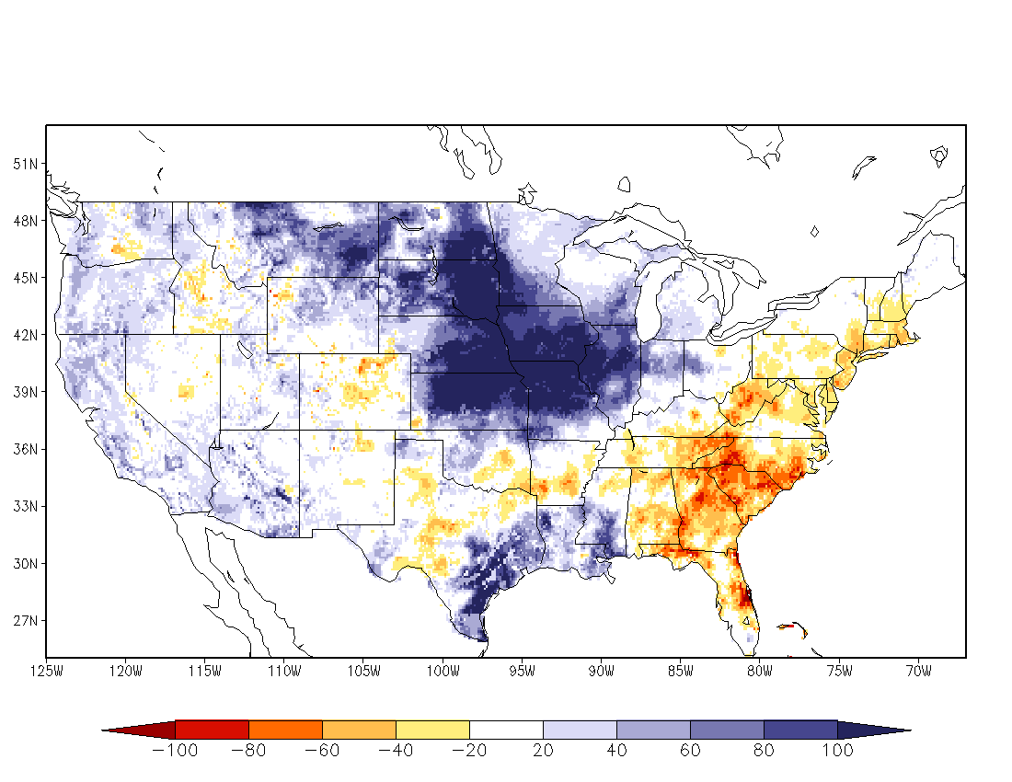
NLDAS: Simulations
30-year retrospective land model runs, Oct 1979 – Sep 2008 (after 15-year spin-up) to provide land model climatologies.
Quasi-operational near real-time, Sep 2008–July 2014
NCEP operational, August 2014 - present, hourly, 0.125-deg, CONUS domain.
Land model output: surface fluxes (latent, sensible & soil heat fluxes, & net radiation), soil states (soil moisture, temperature & ice), runoff/streamflow.
Depict conditions as anomalies and percentiles.
Ek et al., GEWEX Newsletter, 2011, Xia et al., JGR-Atmos, 2012a; 201b
July 30-year climatology
July 1988 (drought year)
July 1993 (flood year)
NLDAS four-model ensemble monthly soil moisture anomaly
4

Slide 5
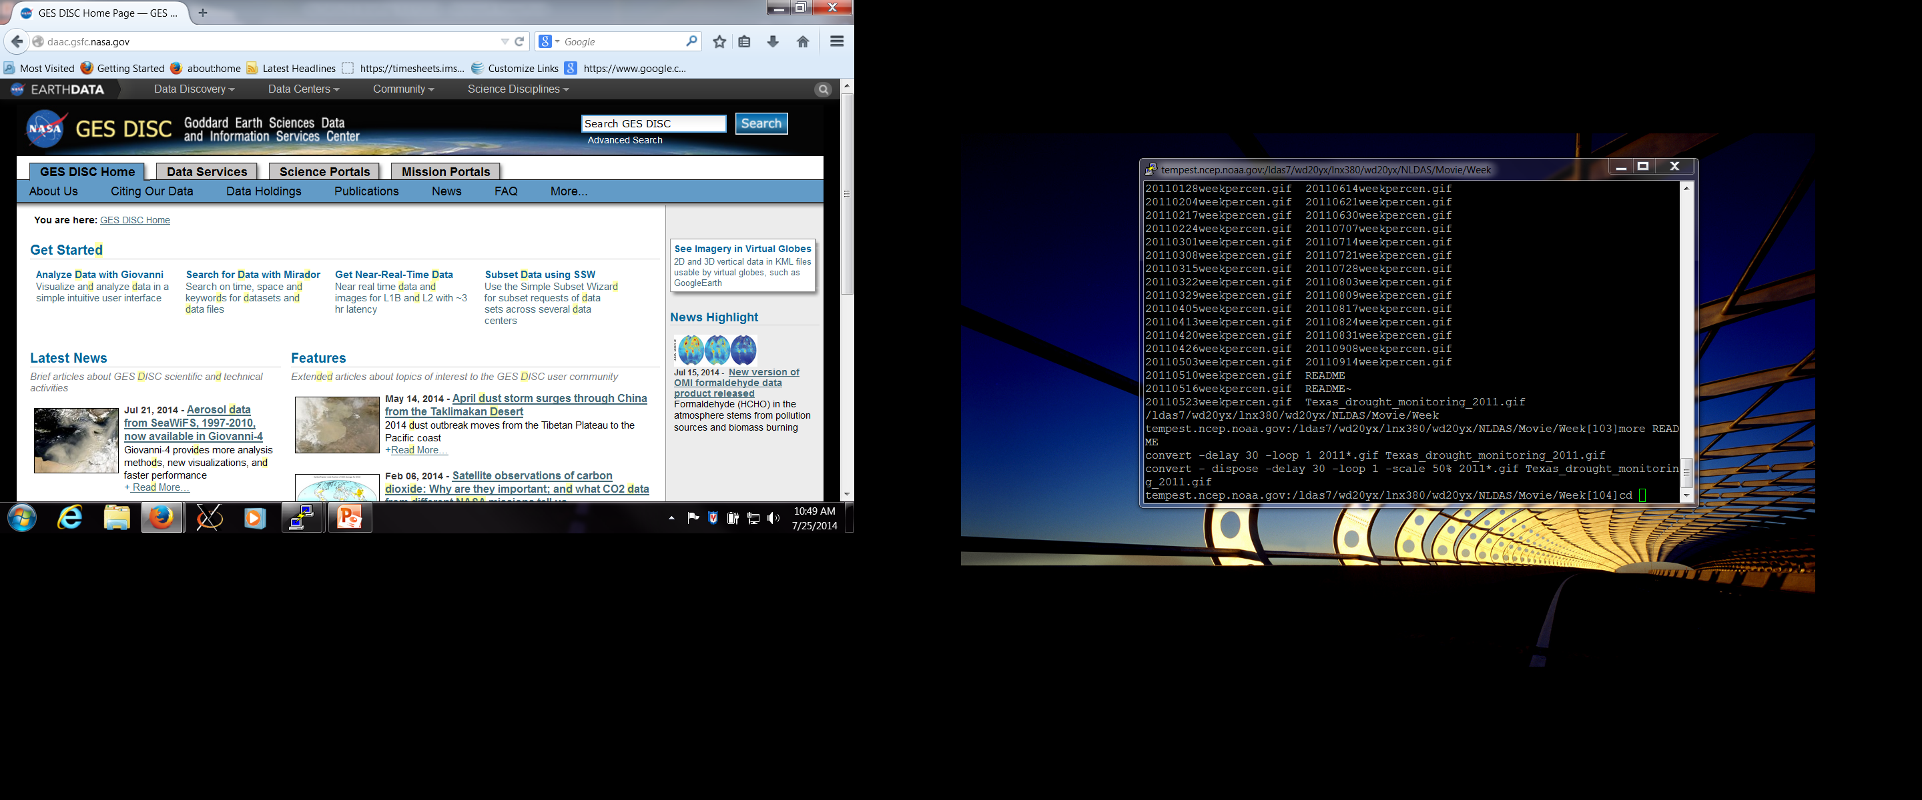
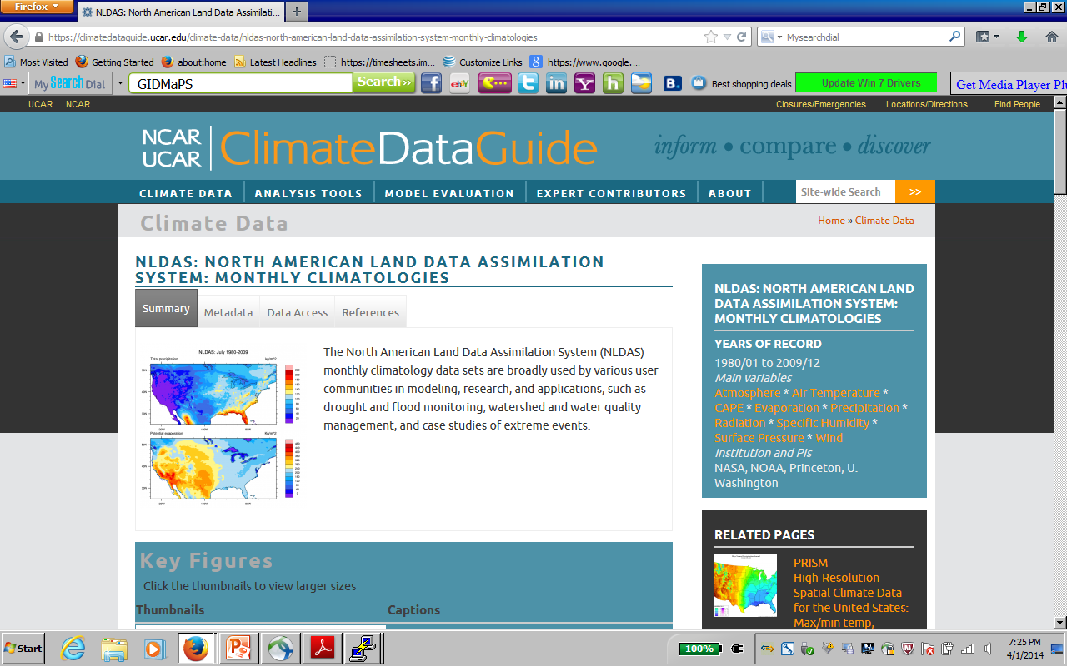


NLDAS Users Information Report
Users Statistics Information from NASA/GES/DISC website – an example
Year | No. of Users | No. of Files Downloaded | Total Volume Downloaded
2017 2016 | 5279 5038 | ~ 56 million ~64 million | 149 TB 149 TB
2015 | 5392 | ~71 million | 144 TB
2014 | 5437 | ~44 million | 93 TB
2013 | 4868 | ~ 36 million | 66 TB
NASA
Statistics
EMC LDAS ftp://ldas.ncep.noaa.gov/nldas2/

Slide 6
Our NCEP/EMC NLDAS team acknowledges all NLDAS partners. Without their contributions, the NLDAS is impossible to become a NCEP operational product. As NLDAS v2.0 has a 3.5-4 day lag behind real-time, based on users’ request (e.g., USDM) and our survey conducted in 2016 and 2017, we update NLDAS v2.0 into version 2.5 by using various feasible data sources (NAMv4, Stage IV) to catch up real-time system.
Highlight: Add timely needed products to NLDAS users in support for their operational drought (e.g., CPC, ESRL, USDM), NWP forecast (e.g., NASA/MSFC), and researches on water resource (e.g., NASA/GSFC)
6

Slide 7
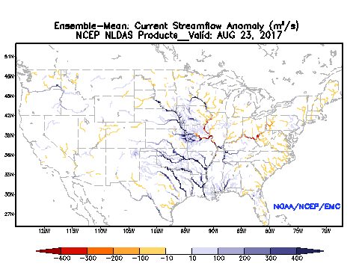

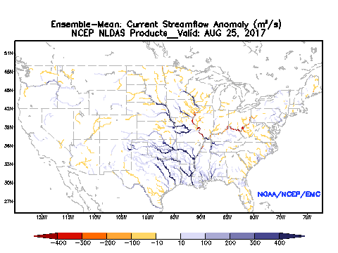
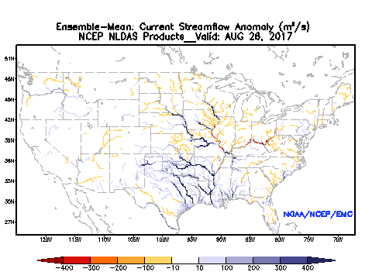
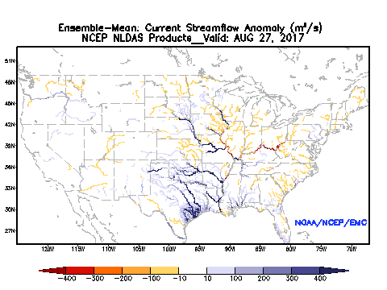

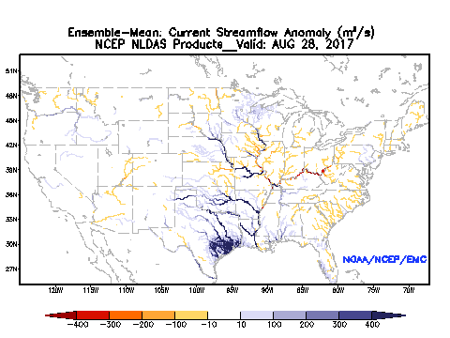
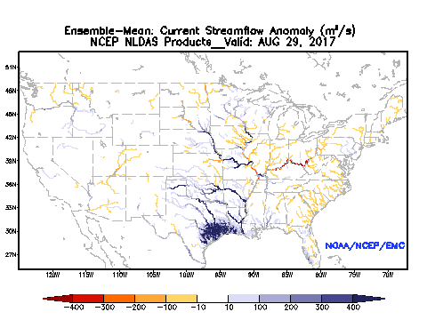
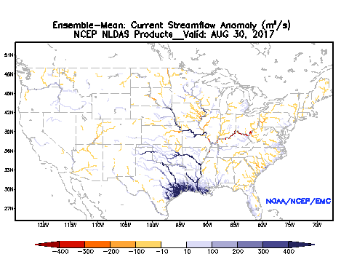
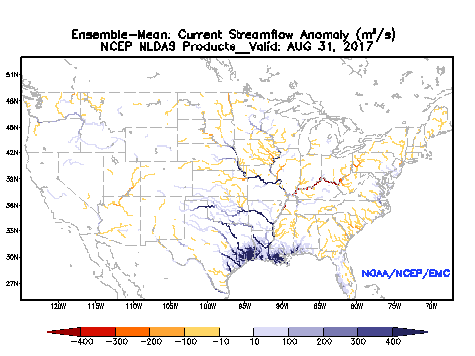
NLDAS2.0 vs NLDAS2.5 (Harvey Case)
Daily Streamflow Anomaly
23 AUG
24 AUG
25 AUG
NLDAS v2.0
26 AUG
27 AUG
27 AUG
28 AUG
29 AUG
NLDAS v2.5
30 AUG
31 AUG
Timing has large impact for monitoring flood situation

Slide 8
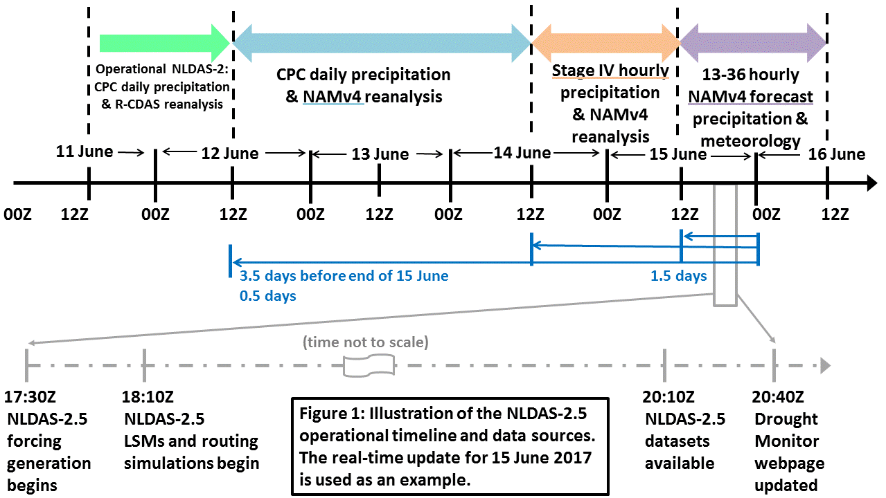
NLDAS v2.5 Flowchart

Slide 9
Operational Four NLDAS Models Run
Add 3.5 day forcing and 3.5-4 day model output
NLDAS Forcing
Hourly precipitation, downward solar radiation, downward longwave radiation, 2m air temperature and specific humidity, 10m wind, and surface pressure
JNLDAS_MOSAIC
(Mosaic Model Run with model parameters, soil texture, vegetation type, 1 core(1), ~20 min, shared, 2.5GB)
JNLDAS_NOAH
Noah Model Run with model parameters, soil texture, vegetation type, 1 core(1), ~15 min, shared, 2.5GB)
JNLDAS_VIC
(VIC Model Run with model parameters, soil texture, vegetation type, 1 core(1), ~150 min, shared, 2.5GB)
JNLDAS_SAC
SAC Model Run with model parameters, soil texture,
vegetation type, 1 core(1), ~15 min, shared, 2.5GB)
Model Outputs
(hydro-meteorological products)
Product
Delivery
9

Slide 10
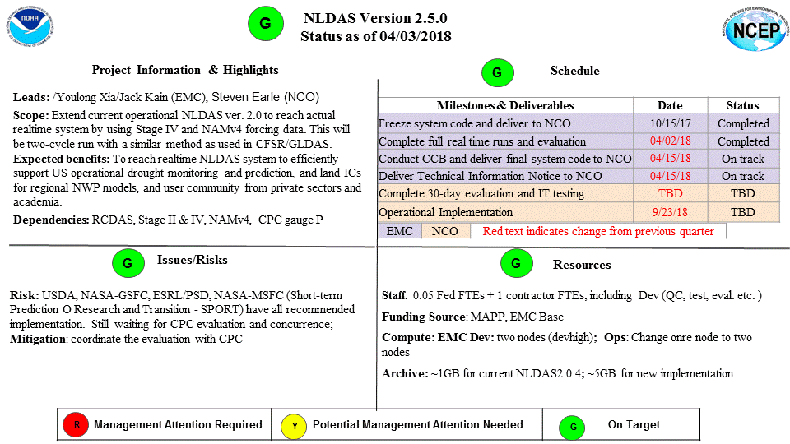
EMC NLDAS v2.5 Quads
After a meeting between EMC and CPC, our NLDAS v2.5 evaluation from NLDAS team to deliver a comprehensive explanation for CPC evaluation, and they agree our proposed implementation as the other 4 evaluation institutes did.
10

Slide 11
NLDAS V2.5.0 Products:
Evaluation and Validation
Most NLDAS 2.0 products have been well comprehensively evaluated against in situ observations and/or remotely sensed data by EMC NLDAS team and its partners. The results were documented in various journal papers and presentaions (https://ldas.gsfc.nasa.gov/nldas/NLDAS2valid.php, https://ldas.gsfc.nasa.gov/nldas/NLDASpublications.php).
Major purpose for this upgrade is to catch up 4-day delay to achieve a real-time system. The data quality will become lower when the data is approaching real-time. Bottom line: NLDAS v2.5 is an add-on, not a replacement of NLDAS v2
Besides we made our own evaluation and monitoring work for NLDAS v2.5 (about 9 months), NASA/GSFC, CPC, NASA-MSFC, ESRL/PSD, and USDA partners also made their own subjective evaluation for NLDAS v2.5. A briefing of these results are presented below.
11

Slide 12
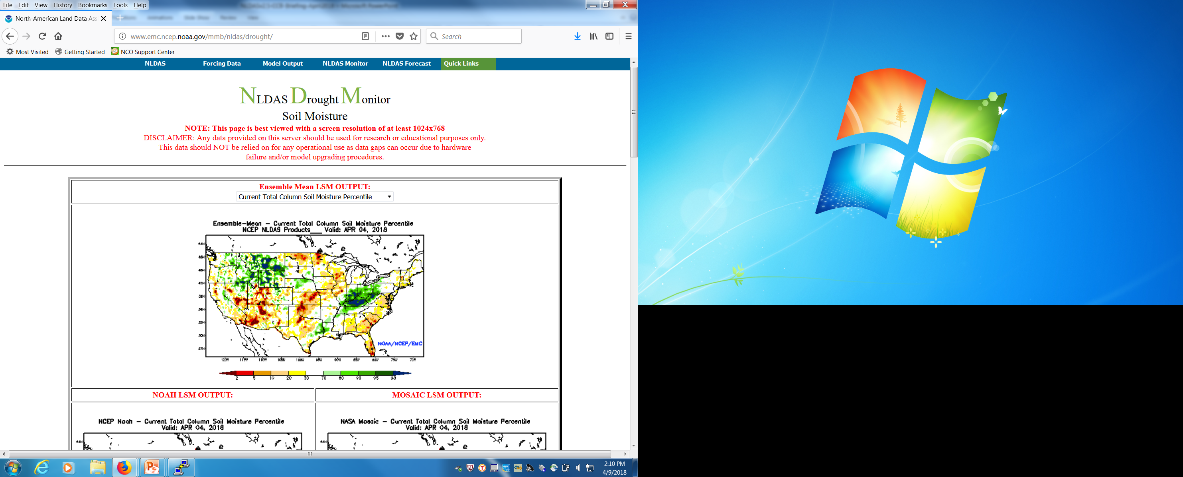
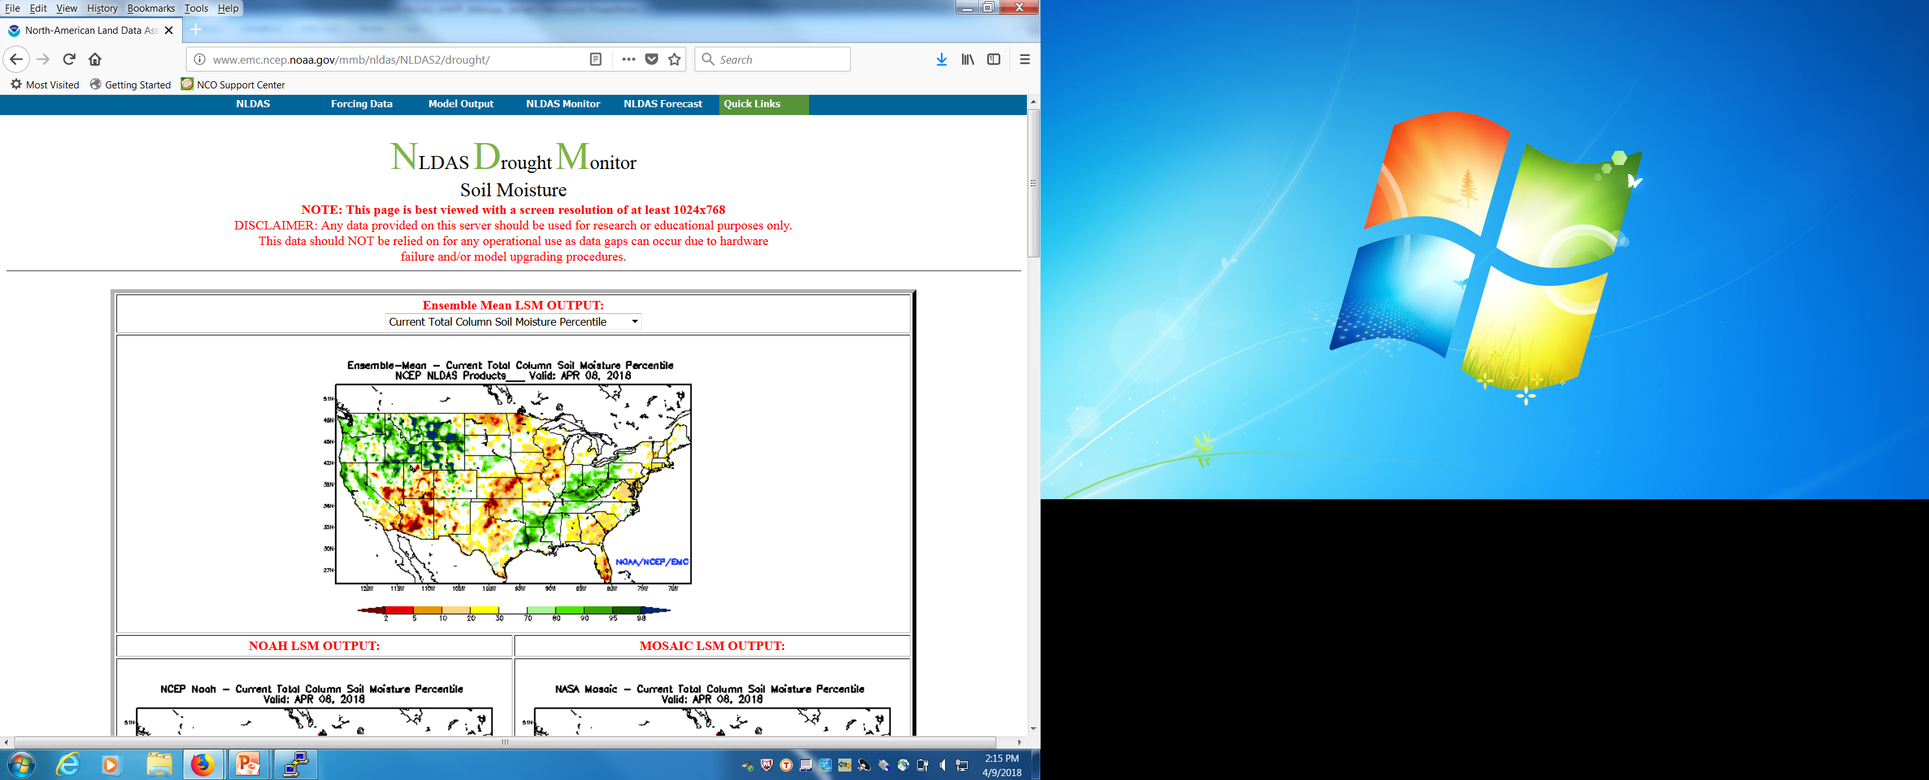
Near Real-time NLDAS v2.0 and Real-time v2.5 drought monitor
Parallel run daily drought monitor
NLDAS v2.0 with 4-day delay
Real-time NLDAS v2.5
http://www.emc.ncep.noaa.gov/mmb/nldas/
http://www.emc.ncep.noaa.gov/mmb/nldas/NLDAS2/
Anomaly and percentile (daily, past week and month) for SM1m, SMtotal, total runoff, routed streamflow, SWE, and ET (4 models: Noah, Mosaic, SAC, VIC, and their ensemble mean)
12

Slide 13
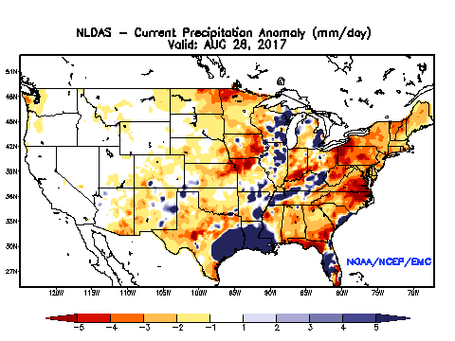
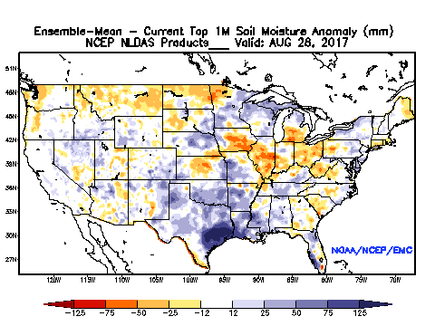
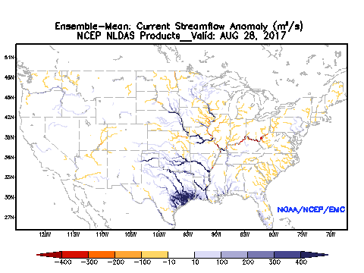
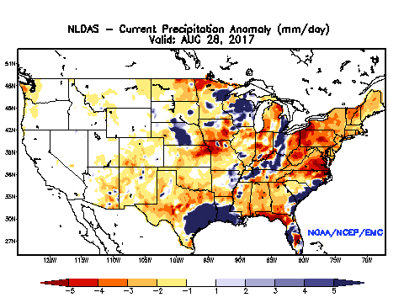
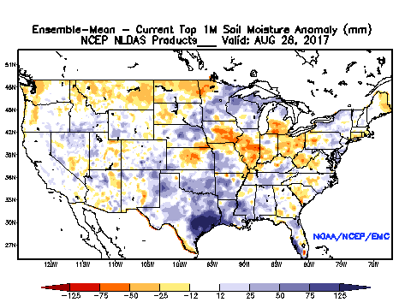
Harvey Case Comparison: NLDAS v2.0 vs NLDAS v2.5
NLDAS v2.0 (generated on 1 September 2017)
NLDAS v2.5 (generated on 28 August 2017)
v2.5 reasonably captures impact of Harvey precipitation immediately and the difference between the two systems is small

Slide 14
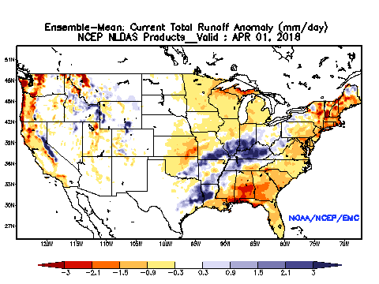
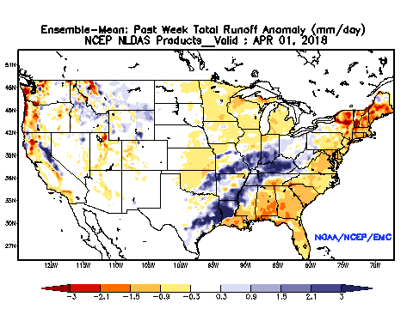
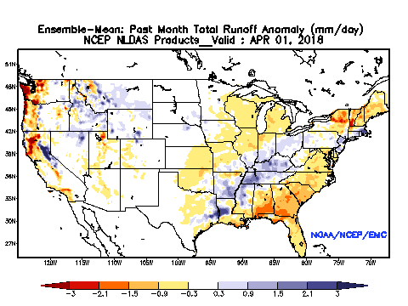
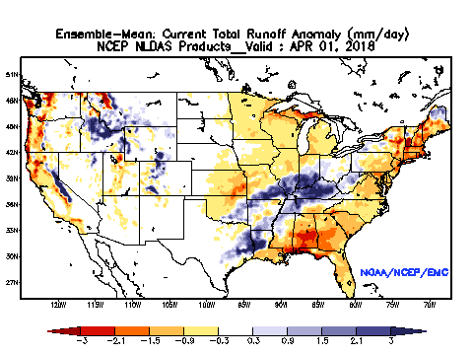
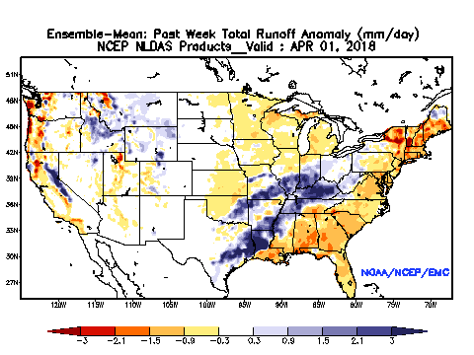

Comparison of total runoff for 3-timescale on 1 April 2018
Near Real-time NLDAS v2.0
Daily Past week Past month
Some difference
Real-time NLDAS v2.5
In spite of some difference in daily total runoff anomaly, weekly and monthly results are quite similar
14

Slide 15
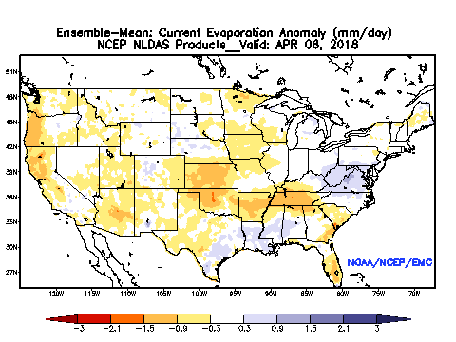
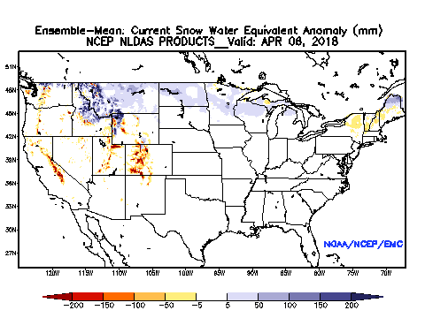
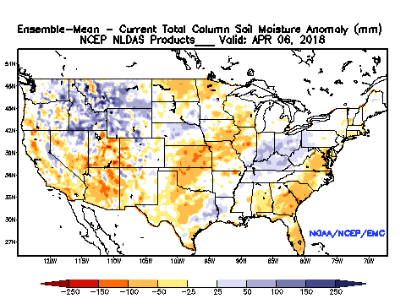
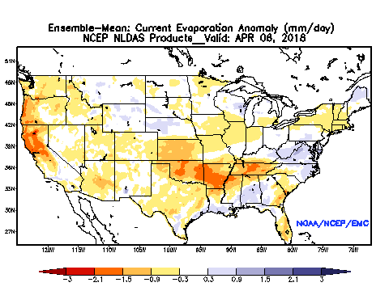

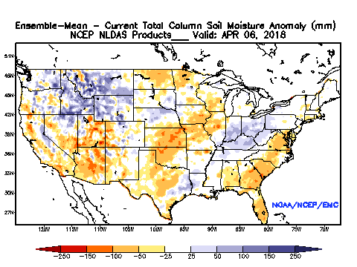
Daily Comparison of Various Variables on 6 April 2018
Near Real-time NLDAS v2.0
ET SWE SM total column
Real-time NLDAS v2.5
There is small-moderate effect on daily ET and runoff, and there is small effect on daily SWE and soil moisture (state)
15

Slide 16
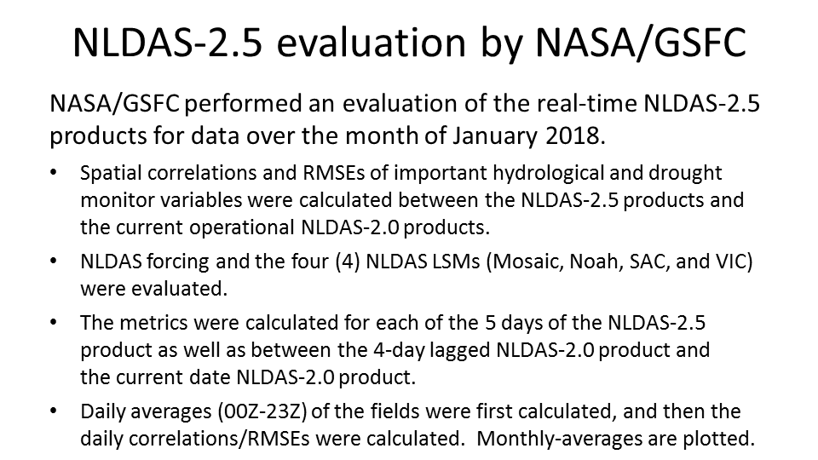
NLDAS v2.5: Users Evaluation
Benchmark – persistence, use January 2018 data to make evaluation
16

Slide 17
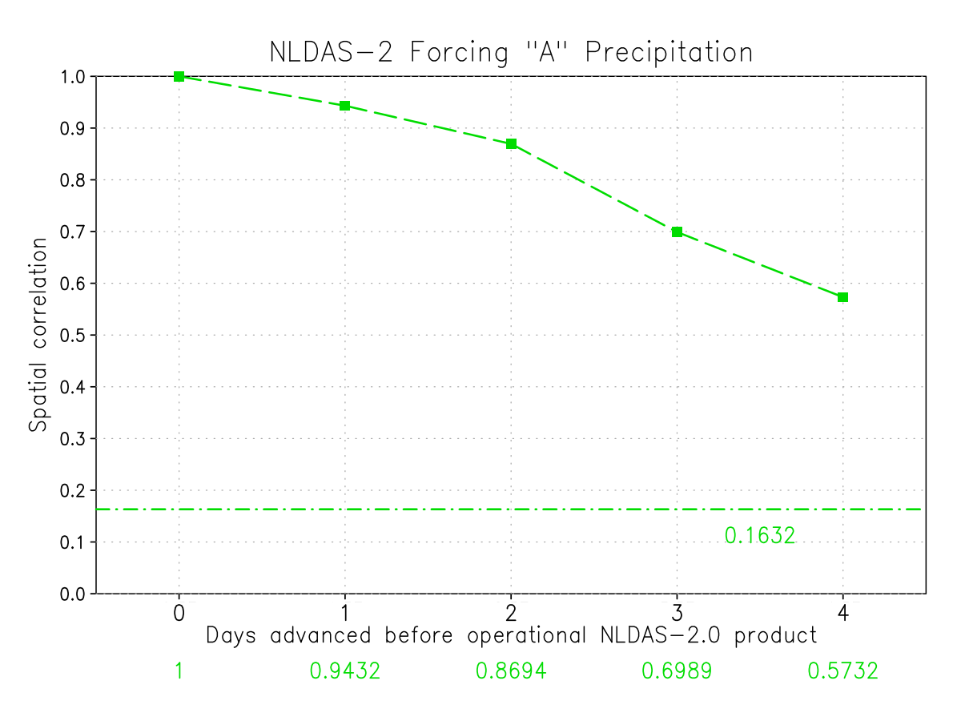
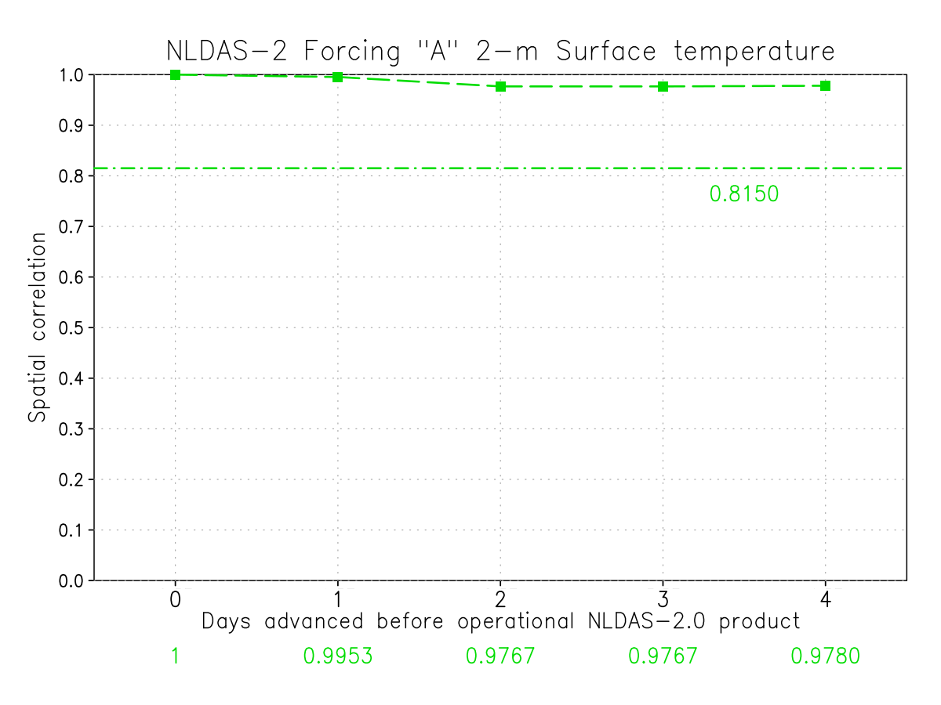
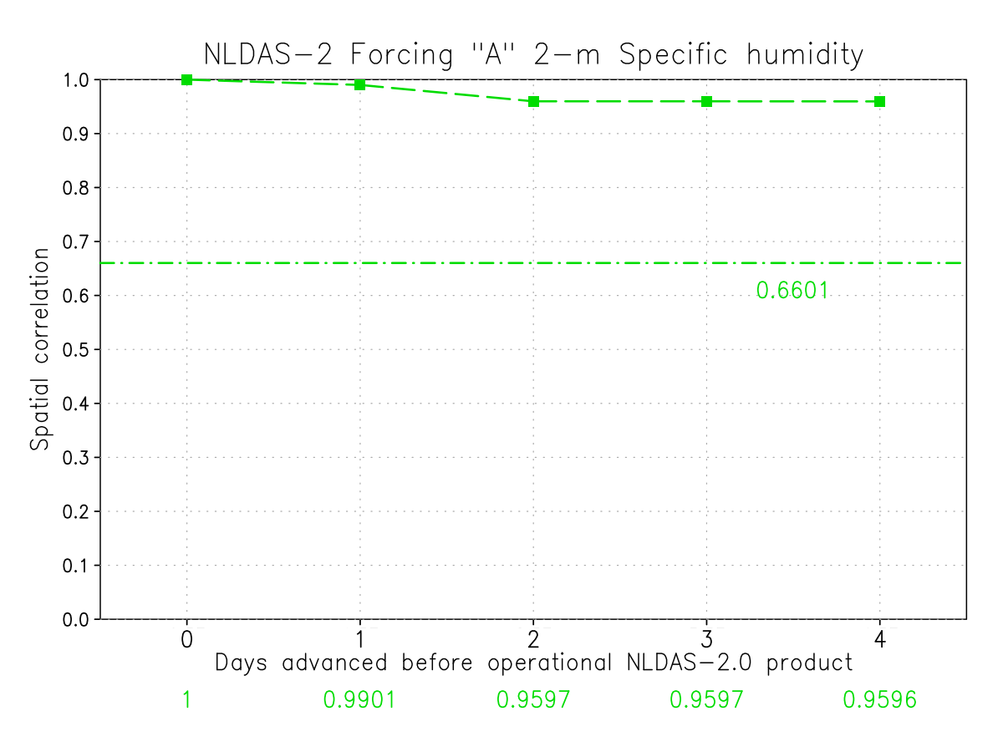
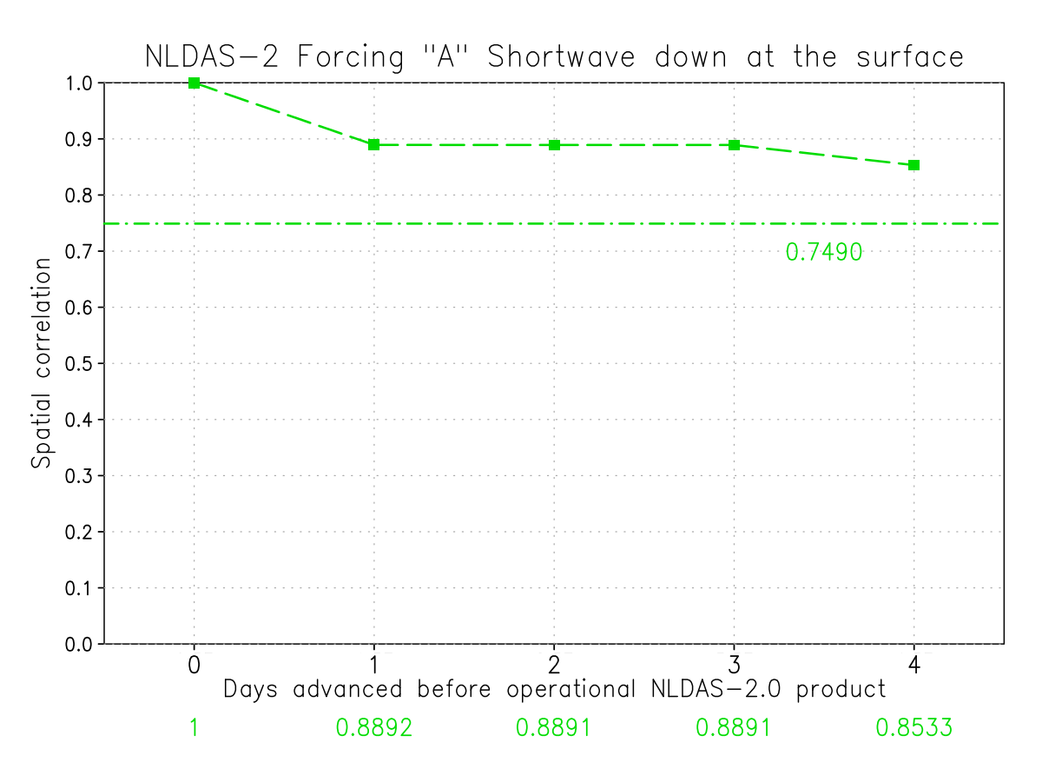
NLDAS v2.5 Forcing and Output Evaluation
(a) Precipitation
(b) 2m Air Temperature
(c) 2m Specific Humidity
(d) Downward Shortwave
17

Slide 18
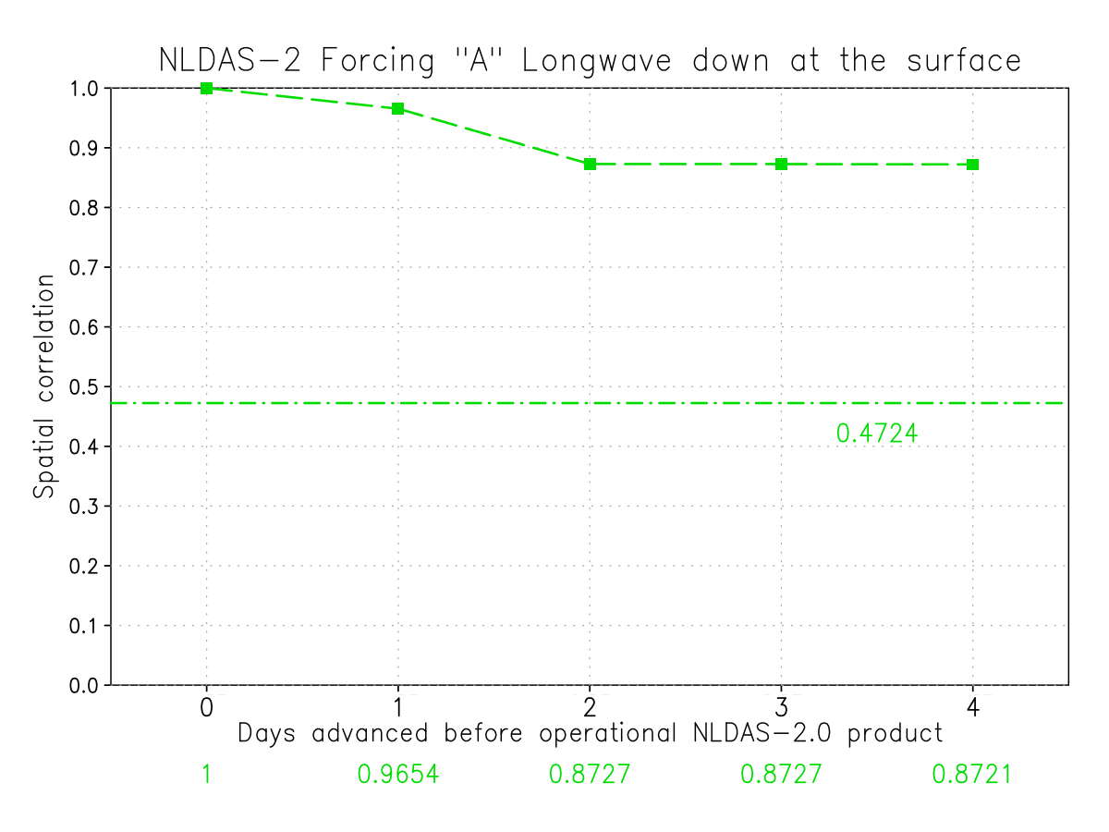
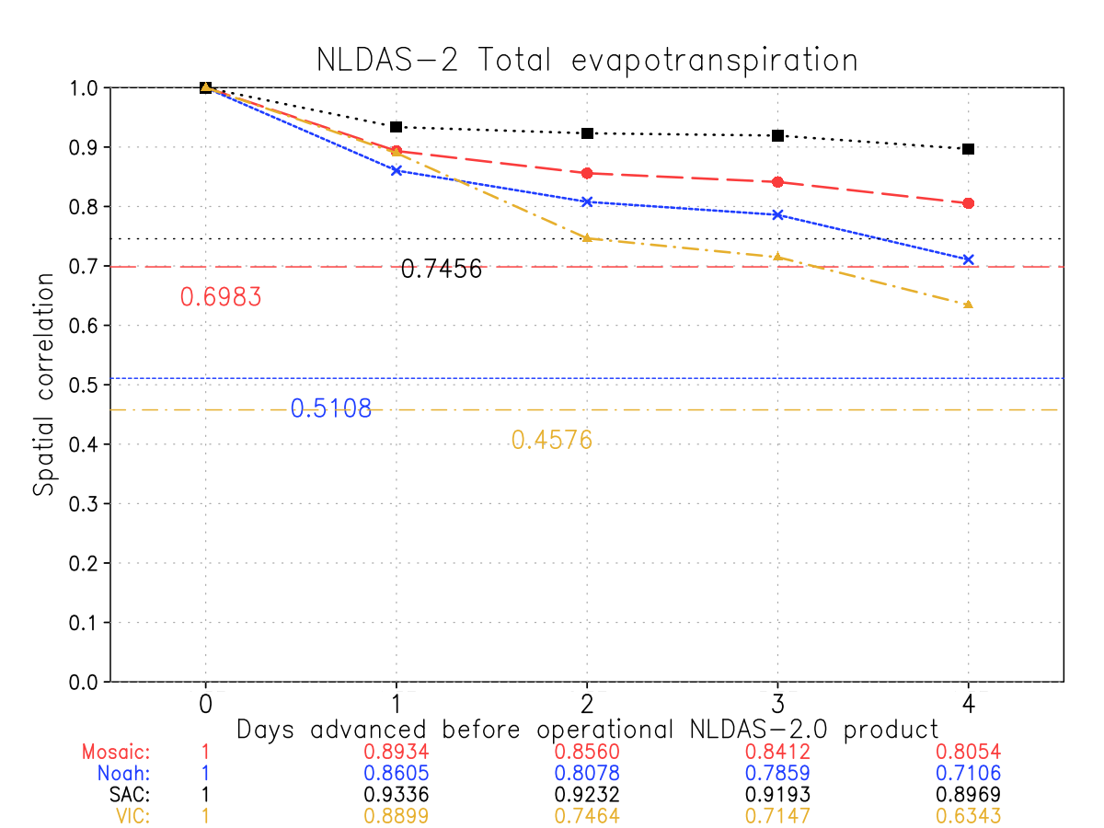
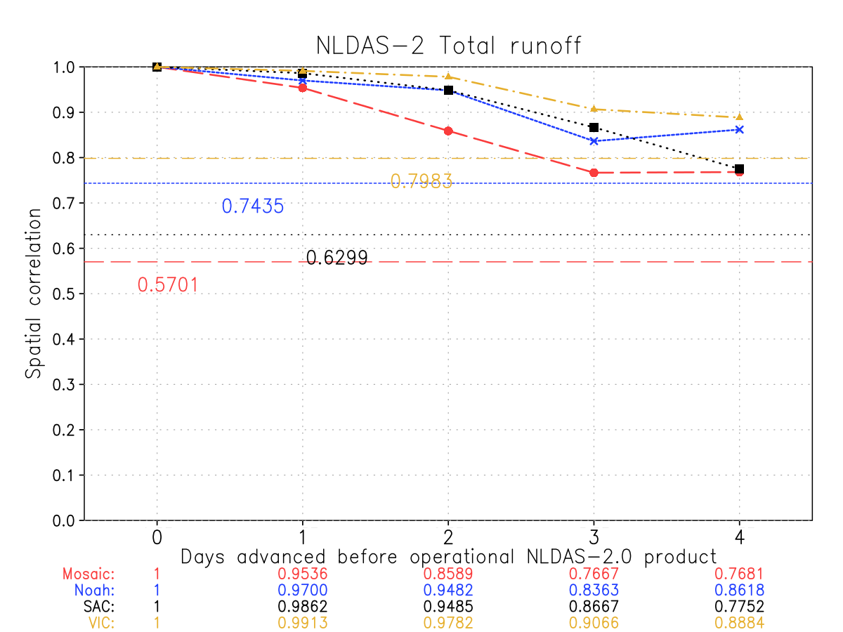
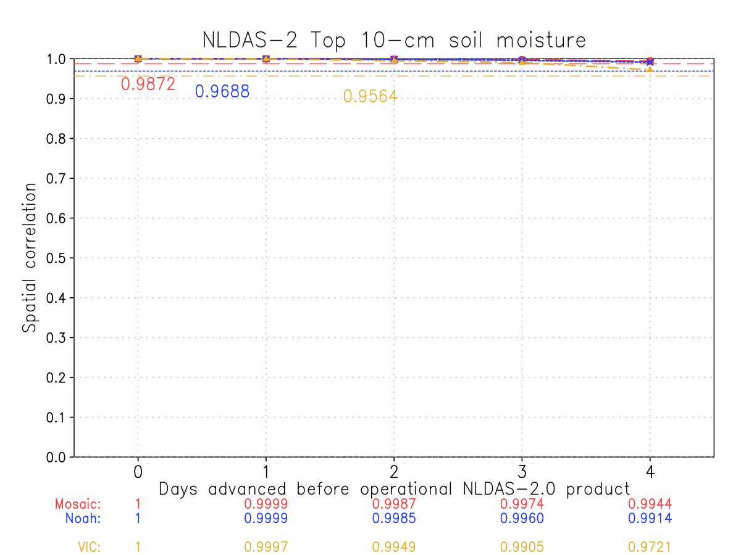
NLDAS v2.5 Forcing and Output Evaluation (Cont.)
(a) Downward Longwave
(b) ET
(c) Total Runoff
(d) Top 10 cm SM
18

Slide 19
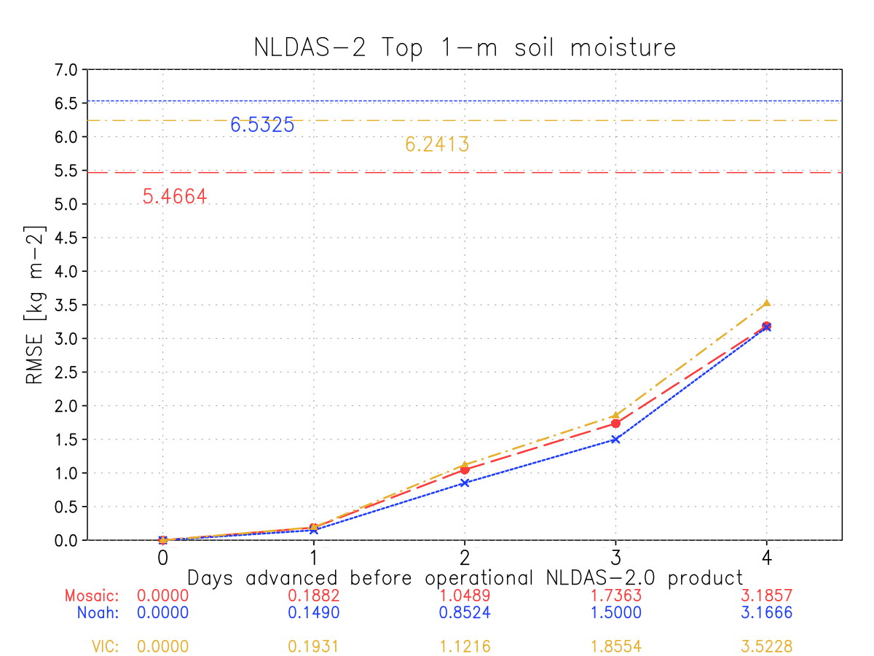
NLDAS-2.5 LSM evaluation - RMSE
Day 4 (current date):
NLDAS-2.5 has the highest RMSE values compared to the NLDAS-2.0 on the same date (half the precip. is from the NAMv4 forecast; the other half is from Stage II)
Day 3 (1-day lag):
Precip. ½ from Stage II and half from CPC analysis
Day 2 (2-day lag):
Precip. from CPC analysis
Day 1 (3-day lag):
Precip. from CPC analysis
Day 0 (4-day lag):
Precip from CPC analysis. RMSE = 0 because it is the same day and precip source as NLDAS-2.0.
The flat line on the top represents the RMSE between the NLDAS-2.0 precip. on a day against the NLDAS-2.0 precip. 4-days earlier. In other words, if you only had the 4-day lagged NLDAS-2.0 precip. on the date you need the latest NLDAS dataset (aka, the current operational system), how useful would it be? The lower RMSE value of the NLDAS-2.5 product below this flat line show that NLDAS-2.5 is improved.
Volumetric <3.5%
19

Slide 20
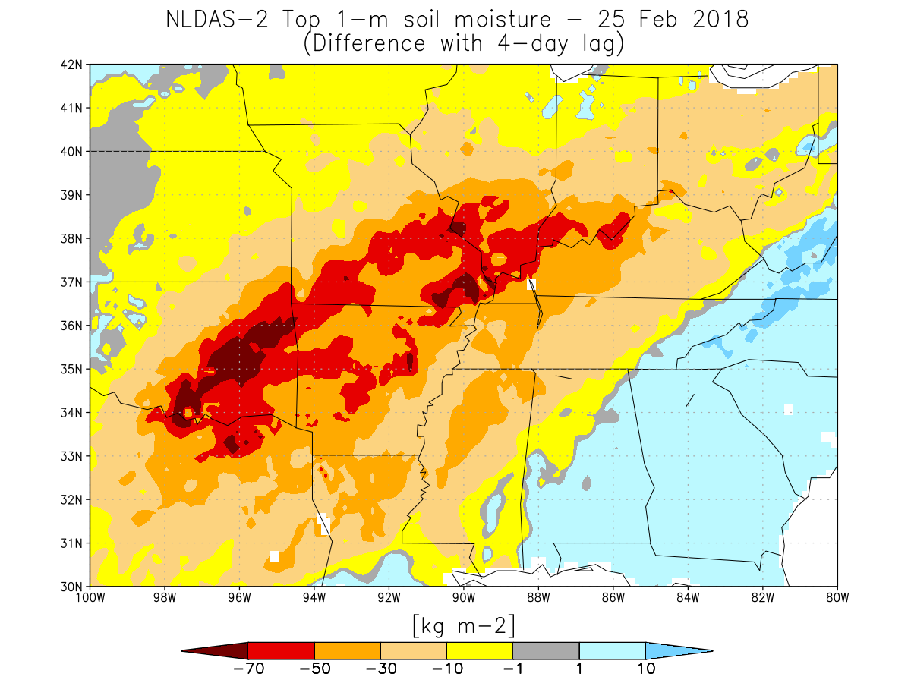
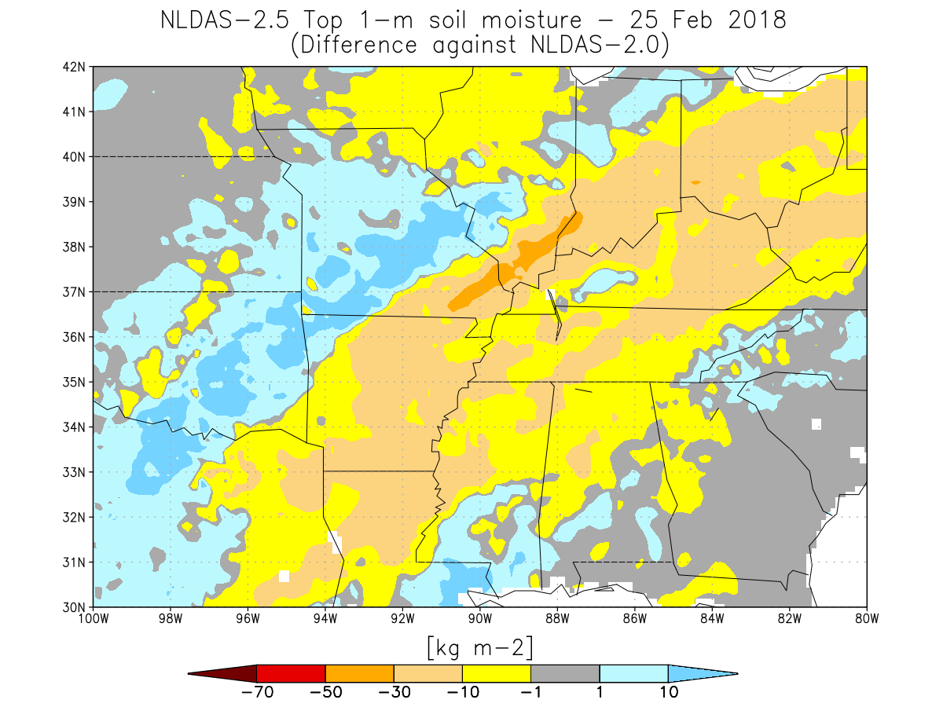
NLDAS-2.5 LSM drought recovery
LEFT) NLDAS-2 for 21 Feb 2018 RIGHT) NLDAS-2.5 for 25 Feb 2018
minus NLDAS-2 from 25 Feb 2018 minus NLDAS-2 from 25 Feb 2018
(test available on 25 Feb 2018) (available on 25 Feb 2018)
This period was immediately after the end of a heavy rain period in the central U.S.
Same fields, only taking the difference between the two products as available on 25 Feb 2018
The more timely actual real-time NLDAS-2.5 data has a greatly reduced bias on this day
20

Slide 21
NLDAS-2.5 evaluation by NASA/GSFC
Conclusions:
NLDAS-2.5 real-time products are an improvement over using NLDAS-2.0 4-day lagged products for operational drought monitoring.
The current NLDAS-2.0 system should continue to run operationally to provide a long-term consistent climatology.
NASA/GSFC recommends that the NLDAS-2.5 system be run operationally in its present form.
21

Slide 22
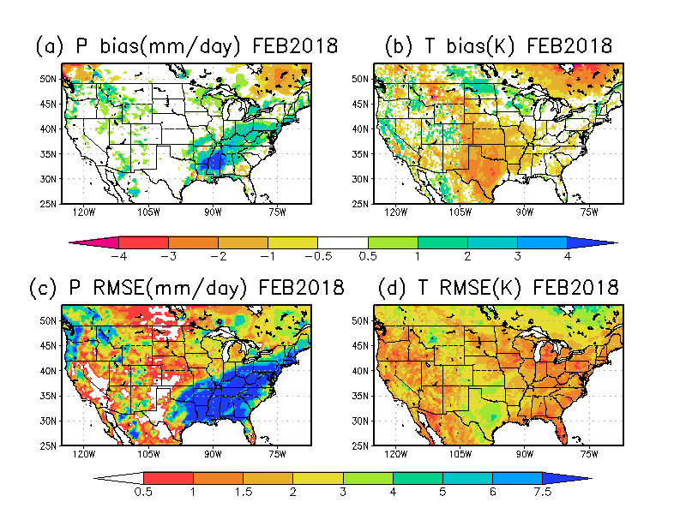
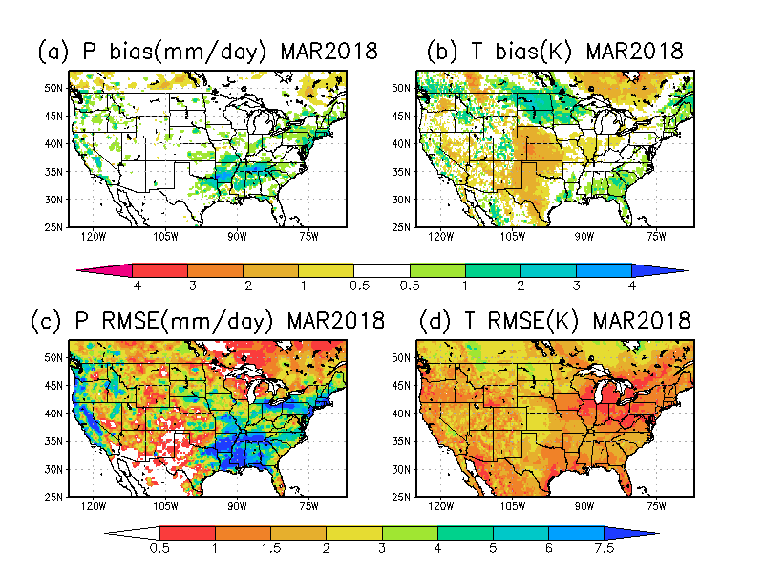
EMC NLDAS Team Re-evaluation for Day 3 based CPC evaluation findings (NLDAS-2.5: stage II radar precip, NAMv4 2m air temperature)
February
Confirm correct codes and scripts
Confirm that Stage II radar precipitation leads to errors
Confirm not due to orographic adjustment for T but two systems (NARR vs NAMv4)
March has smaller error when compared with February
March
For 2m air temperature error, no matured algorithm and/or reasonable observed based product can be used in present status. We are ready if any progress will be made in future, we will upgrade our system as soon as possible.
22

Slide 23
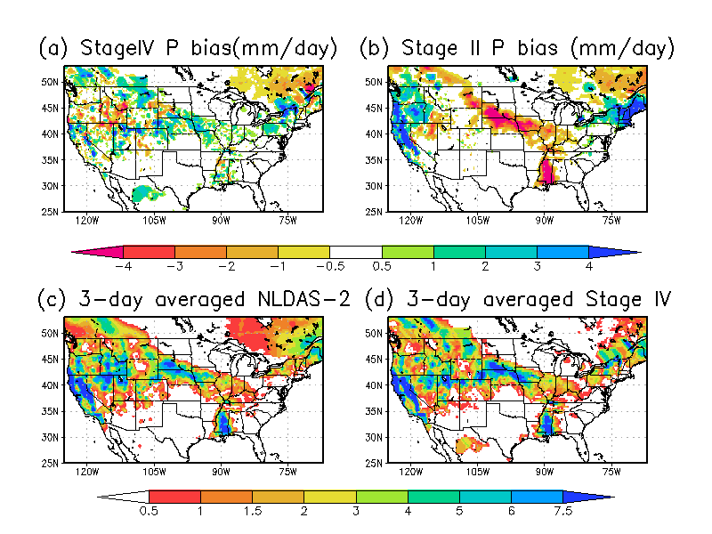
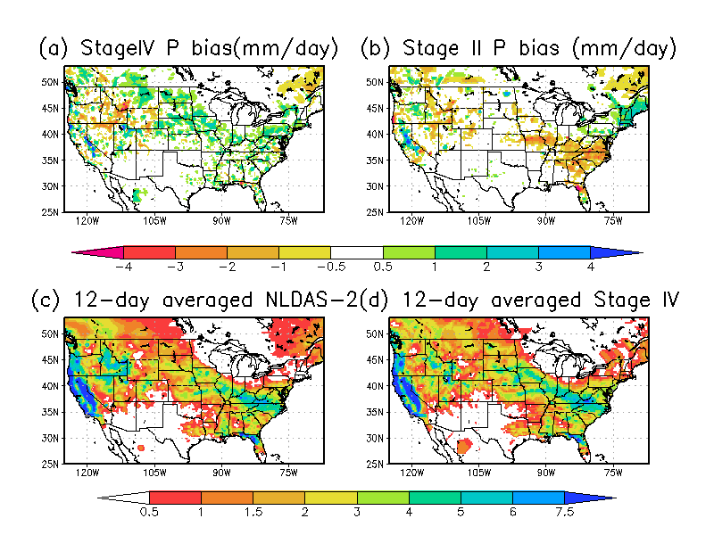
EMC NLDAS Team Evaluation for Stage II and IV
14-17 March 2018
14-27 March 2018
23

Slide 24
Stage II vs IV
Based on review for references of comparison of Stage II and Stage IV, some experts inquiry [Ying Lin (Stage II and IV), Yan Luo (CCPA), Jack Kain] and our own preliminary evaluation,
we decide to use hourly Stage IV to replace Stage II for NLDAS v2.5 real-time catchup run. We still use Stage II hourly for NLDAS v2.0 run (mainly for temporally downscaling for daily CPC gauge precipitation) to keep the consistency with 30-year (1979-2008) retrospective run and previous near-real-time run (2009-present).
The advantage is that the users can base on their application purposes to select NLDAS v2.5 output.

Slide 25
Information of 5 Evaluation Institutes
All evaluation Institutes agree with present implementation plan
NASA/GSFC Hydrological Sciences Laboratory (NASA/GSFC/HSL, Christa Peters-Lidard, David Mocko)
NCEP Climate Prediction Center (NCEP/CPC, Muthu Chelliah , Gwen Chen)
USDA Office of the Chief Economist and USDM author (USDA/OCE, Eric Luebehusen)
NOAA Earth Science Research Laboratory (NOAA/ESRL, Mike Hobbins)
NASA MSFC Short-term Prediction Research and Transition Center (NASA/MSFC/SPORT, Jonathan Case)
25

Slide 26



NLDAS v2.5: Data Distribution
http://www.emc.ncep.noaa.gov/mmb/nldas/
EMC LDAS ftp site -ftp://ldas.ncep.noaa.gov/
Other Distribution Sites: UCAR, USGS, CDC WONDER (Centers for Diseases Control and Prevention), etc.

Slide 27
Future Development of NCEP LDAS

Slide 28
NLDAS
Run NLDAS under NASA Land Information System (LIS) parallel environment, latest land model versions, land data assimilation and validation tools.
Improve atmospheric and observational precipitation and air temperature forcing; data sets (e.g. land use, soils, greenness).
Improve land model physics (e.g., irrigation, ground water, vegetation dynamics, carbon and nitrogen cycle).
Land data assimilation: snow, soil moisture, GRACE.
Higher res/downscaling, enhance land model spin-up.
Extend NLDAS domain (entire North America, eventually global); initial land cond. for FV3GFS.
28

Slide 29
Collaboration Research of NLDAS Development between EMC and NASA sponsored by CPO/MAPP
(NASA scientists, EMC scientists)
CPO/MAPP/NLDAS FY11-13:Assimilating Soil Moisture and Snow Products for Improved Drought Monitoring with the North American Land Data Assimilation System (NLDAS) DA (Peters-Lidard, Mocko, Kumar, Ek, Xia, Dong)
CPO/MAPP/NLDAS FY14-16: Advancing Probabilistic Drought Monitoring through Multisensor Ensemble DA (Peters-Lidard, Mocko, Kumar, Wamg, Ek, Xia, Dong)
CPO/CTB/NLDAS FY17-18:Operational Transition of Soil Moisture and Snow Data Assimilation in the North American Land Data Assimilation System (NLDAS) (Peters-Lidard, Mocko, Kumar, Ek, Xia, Dong)
CPO/MAPP/NLDAS FY18-20: Representing human-managed influences through thermal and vegetation product data assimilation in NLDAS: Impacts on the terrestrial water budget and drought estimation (Peters-Lidard, Mocko, Kumar, Hain, Xia)
These efforts are being integrated to use for NLDAS-3
Kumar et al., J. Hydrometeor, 2016; Kumar et al., WRR, 2017, Xia et al., JGR-atmos., 2016a; 2016b, Xia et al., J. Hydrometer., 2017

Slide 30


NULDAS development and future plan – white paper
NULDAS development and update will help enhance its capability for both drought and flooding monitoring task, as well as optimal ICs for coupled system.
http://www.emc.ncep.noaa.gov/mmb/nldas/White_Paper_for_Next_Phase_LDAS_final.pdf

Slide 31
Interaction with other EMC projects and outside community
Speed up NULDAS development via unifying NLDAS and GLDAS (e.g., forcing generation, model choice, and system test)
Efficiently use radar, reanalysis and model product in NULDAS testbed via collaboration with EMC scientists
Enhance couple model system tests (e.g., FV3GFS) for land model (Noah, Noah-MP) to identify key parameters and processes to improve skills from sub-seasonal to seasonal forecast
Achieve standalone->SCM->fully coupled system test strategy
Enhance internal collaboration within EMC, in particular related to atmospheric and boundary layer physics processes – working two systems together
Speed up development and transition of land-related processes (lake, groundwater, irrigation, vegetation dynamics, wild fire, biochemistry, and ecosystem, global river router) to Noah or Noah-MP model to meet EMC coupled system requirements.
Use land model as a component to support for coupled system upgrade and development at EMC

Slide 32
References (EMC scientists are indicated in bold)
Kumar, S.V., S. Wang, D. M. Mocko, C.D. Peters-Lidard, and Y. Xia, 2017: Similarity Assessment of Land Surface Model Outputs in the North American Land Data Assimilation System (NLDAS). Water Resources Research, 53, 8941-8965.
Xia, Y., D.M. Mocko, M. Huang, B. Li, M. Rodell, K.E. Mitchell, X. Cai, and M.B. Ek, 2017: Comparison and Assessment of Three Advanced Land Surface Models in Simulating Terrestrial Water Storage Components over the United States. J. Hydrometeor., 18, 625-649.
Kumar, S.V., B. F. Zaitchik, C. D. Peters-Lidard, M. Rodell, R. Reichle, B. Li, M. Jasinski, D. Mocko, A. Getirana, G. De Lannoy, M. H. Cosh, C. R. Hain, M. Anderson, K. R. Arsenault, Y. Xia, and M. Ek, 2016: Assimilation of Gridded GRACE Terrestrial Water Storage Estimates in the North American Land Data Assimilation System, J. Hydrometeor., 17, 1951-1972.
Xia, Y., B. A. Cosgrove, K. E. Mitchell, C. D. Peters-Lidard, M. B. Ek, M. Brewer, D. Mocko, S. V. Kumar, H. Wei, J. Meng, and L. Luo, 2016a: Basin-scale Assessment of the Land Surface Water Budget in the NCEP Operational and Research NLDAS-2 Systems. J. Geophys. Res. - Atmos., 121 (6), 2750-2779.
Xia, Y., B. A. Cosgrove, K. E. Mitchell, C. D. Peters-Lidard, M. B. Ek, S.V. Kumar, D. Mocko, and H. Wei, 2016b: Basin-scale Assessment of the Land Surface Energy Budget in the NCEP Operational and Research NLDAS-2 Systems. J. Geophys. Res.- Atmos., 121 (1), 196-220.
Xia, Y., K. E. Mitchell, M. B. Ek, J. Sheffield, B. Cosgrove, E. Wood, L. Lou, C. Alonge, H. Wei, J. Meng, B. Livneh, D. Lettenmaier, V. Koren, Q. Duan, K. Mo, Y. Fan, and D. Mocko, 2012a: Continental Water and Energy Flux Analysis and Validation for North-American Land Data Assimilation System Project Phase 2, Part 2: Comparison Analysis of Multi-model Results. J. Geophys. Res.- Atmos., 117, D03109, doi:10.1029/2011JD016048.
Xia, Y., K. E. Mitchell, M. B. Ek, B. Cosgrove, J. Sheffield, L. Luo, C. Alonge, H. Wei, J. Meng, B. Livneh, Q. Duan, and D. Lohmann, 2012b: Continental Water and Energy Flux Analysis and Validation for North-American Land Data Assimilation System Project Phase 2, Part 2: Validation of Simulated Streamflow. J. Geophys. Res.- Atmos., 117, D03110, doi:10.1029/2011JD016051.

Slide 33
Thanks for your attention!
Comments and Suggestions:
Dr. Youlong Xia: Youlong.Xia@noaa.gov
Dr. Jack Kain: Jack.Kain@noaa.gov
33

